Slide 1
Security and privacy aware handover authentication for next generation mobile networks
Project Presentation By
18JE0746 Satyavart Scholar : Prasanta Kumar Roy Guide : Dr. Ansuman Battacharya

Slide 2
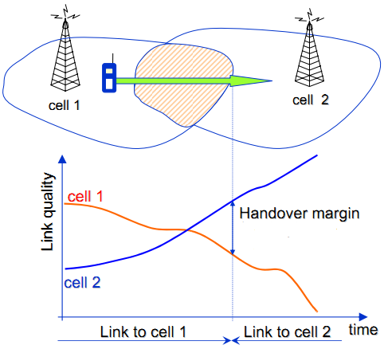
What is Handover?
A handover is a process in telecommunications and mobile communications in which a connected cellular call or a data session is transferred from one cell site (base station) to another without disconnecting the session.
Cellular services are based on mobility and handover, allowing the user to be moved from one cell site range to another or to be switched to the nearest cell site for better performance.
Handovers are a core element in planning and deploying cellular networks

Slide 3
Classification of Handover
Handover
Inter-domain
Intra-domain
Hard
Soft
Hard
Soft

Slide 4
Efficieny Requirement (LTE, 5G, Next Gen. mobile network)
Increase system capacity
Increase seamless mobility
Higher resource utilization
Improve coverage area
Note: Heterogenous Network Connectivity
Maintaining universality

Slide 5
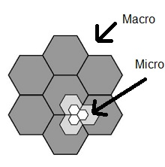
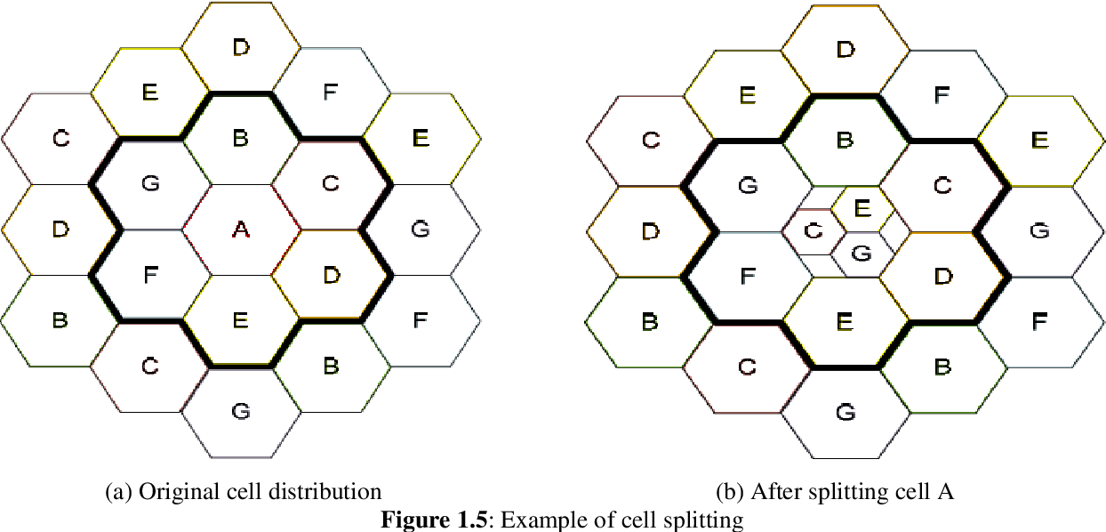
Possible Solution
Increasing small cell deployment density under macro cell coverage (cell spitting and cell sectoring).
Micro-cell, pico-cell, fem-to-cell
Logically centralized and physically distributed control over heterogenous network (EPC, SDN like approach).
Fig.2 Cell splitting
Fig.3 Cell Sectoring

Slide 6
Security Requirement
Confidentiality
Integrity
Entity Authentication
Data Authentication
Availability
DoS
Desynchronization
Resistant to active and passive attacks
Session Key Secrecy
Forward/Backward Secrecy
Key Escrow
Ephemeral Secret Leakage
Privacy
Anonymity
Unlinkability
Conditional Privacy

Slide 7
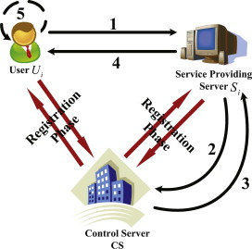
Possible Solution
Mutual Authentication and Key Requirement
Proper Key agreement
Dynamic Key
Desynchronization Resistant
Dynamic Pseudonym
Include short term and long term secrets
Fig.4 Dynamic Pseudonym
illustration
Note: Reduced computational, communicational and storage overweight
Symmetric key best approach is preferred

Slide 8
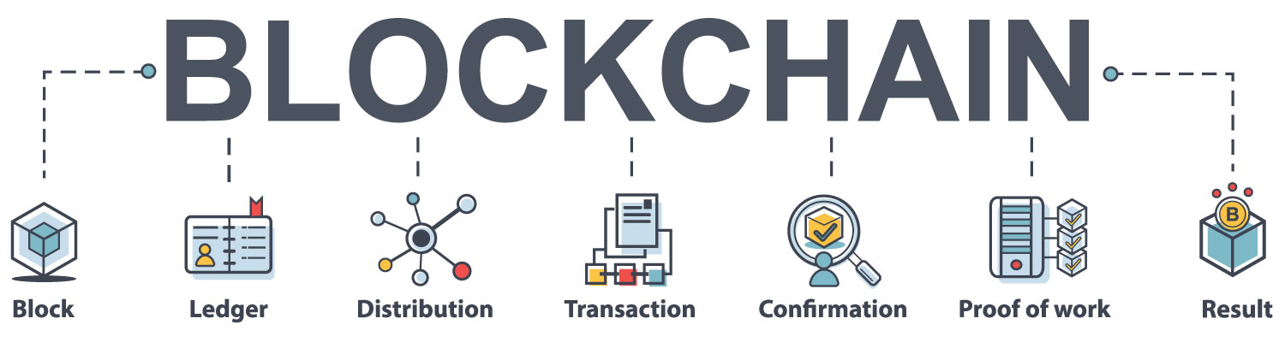
What is Blockchain?
Blockchain is a system of recording information in a way that makes it difficult or impossible to change, hack, or cheat the system.
A blockchain is essentially a digital ledger of transactions that is duplicated and distributed across the entire network of computer systems on the blockchain.

Slide 9
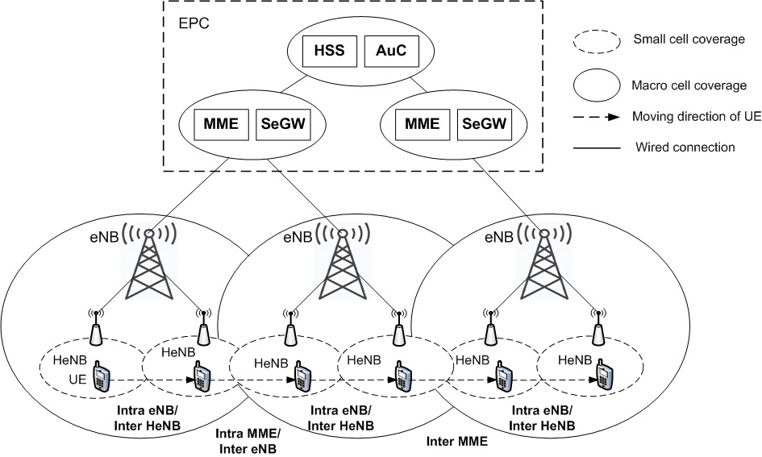
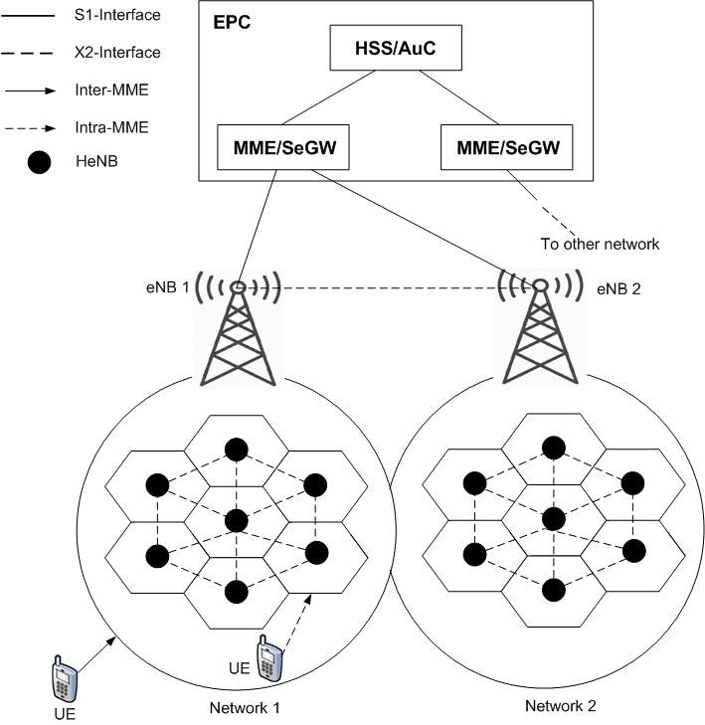
System Model
Fig. Handover scenarios in densely deployed small cell networks

Slide 10
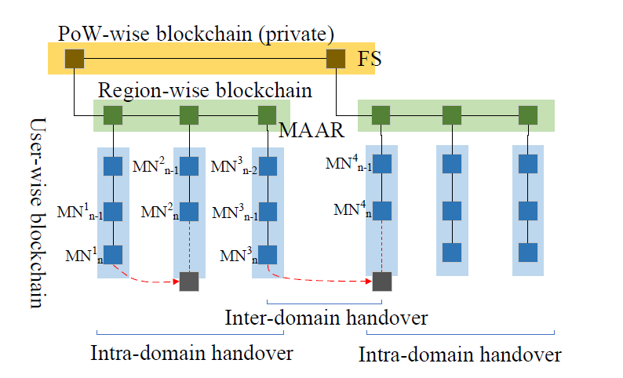
Security Model
Blockchain is proposed for implementation for secure and energy-efficient handover in distributed mobility management.
In this scheme, mutual authentication, confidentiality, integrity, FWS, nonrepudiation, user anonymity, and non-traceability can be guaranteed.
Fig. Blockchain based security model

Slide 11
Security Verification
Computational hardness
BAN Logic
Informal Analysis
Formal Analysis
Real-or-Random Oracle Model
Decisional Hardness

Slide 12
Simulation Platform
Security – AVISPA
Computational Cost/Execution Time – Python(PyCryptodome, PyCrypto, etc.)
Blockchain – Python
System Model – ns3/ Oment++/ Mininet-WiFi

Slide 13
References
A. K. Sutrala, M. S. Obaidat, S. Saha, A. K. Das, M. Alazab, and Y. Park, “Authenticated key agreement scheme with user anonymity and untraceability for 5genabled softwarized industrial cyber-physical systems,” IEEE Transactions on Intelligent Transportation Systems, 2021
R. Canetti and H. Krawczyk, “Universally composable notions of key exchange and secure channels,” in International Conference on the Theory and Applications of Cryptographic Techniques. Springer, 2002, pp. 337–351
C.-C. Chang and H.-D. Le, “A provably secure, efficient, and flexible authentication scheme for ad hoc wireless sensor networks,” IEEE Transactions on wireless communications, vol. 15, no. 1, pp. 357–366, 2015
Burrows, M., Abadi, M., Needham, R.M.: A logic of authentication. Proceedings of the Royal Society of London. A. Mathematical and Physical Sciences 426(1871), 233-271 (1989).
“Desynchronization resistant privacy preserving user authentication protocol for location based services”, PK Roy, A Bhattacharya, Peer-to-Peer Networking and Applications 14 (6), 3619-3633
“A group key-based lightweight Mutual Authentication and Key Agreement (MAKA) protocol for multi-server environment” ,PK Roy, A Bhattacharya, The Journal of Supercomputing, 1-28
“Secure and efficient authentication protocol with user untraceability for global roaming services “, PK Roy, A Bhattacharya, Wireless Networks, 1-18
“Is 5G Handover Secure and Private? A Survey” Dongsheng Zhao, Zheng Yan, Senior Member, IEEE, Mingjun Wang, Peng Zhang, and Bin Song, Senior Member, IEEE
https://pypi.org/project/pycryptodome/

Slide 14
THANKS!

